Slide 1
Changing states
Year 7 Science

Slide 2
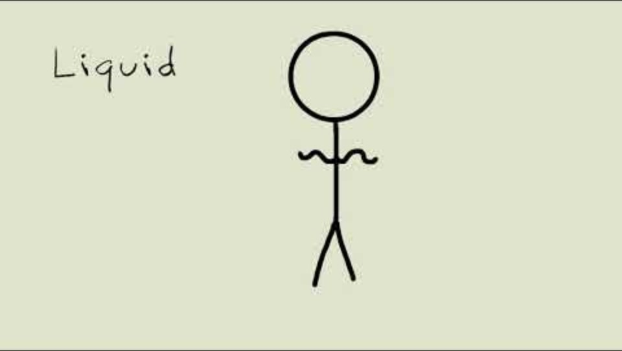
Review
Has the most energy…
Has a fixed volume and shape…
Has a fixed volume but not fixed shape…
Has no fixed volume or shape…
Can be poured…
Can diffuse (spread out to fill the container)…
Has thre strongest bonds between particles…
Has the lowest density…
Ice…
Water vapour…

Slide 3
Learning Intentions
Mixtures, including solutions, contain a combination of pure substances that can be separated using a range of techniques.

Slide 4
Success criteria
Name the phase changes between solids, liquids and gases.
Explain what is happening to particles during phase changes.

Slide 5
States of matter WORKSHEET

Slide 6

Homework: Changes of State
Due next Monday 29 April

Slide 7
Success criteria
Describe the properties of solids, liquids and gases.
Classify examples as solids, liquids or gases.

